Slide 1




SZABMART
CHALLENGE CENTRAL

Slide 2
'Szabist Challenge Central' aims to provide a unique gaming experience.
The stall features interactive board games and video games.
Methodical approach resulted in recognizing PS4's popularity among students.
Competitor analysis revealed a gap in the Szabmart space for an amazing gaming experience.
Trends indicate a preference for fascinating narratives and storyline-driven games.

Slide 3
1
Evolution of Gaming Stall Idea
Ideas
2
Amidst Food Stalls, Need for Gaming Space
3
Students want something engaging & interactive
4
Offering Interactive Board Games & Video Games
5
idea similarities between group members

Slide 4
Survey Overview
Our STP analysis journey begins with a comprehensive survey conducted among - 200 SZABIST students.
Our aim was to understand the student behaviors regarding event attendance, spending habits, and travel patterns.
37.5% of students maintain a spending limit of 500 to 1000 PKR.

Slide 5
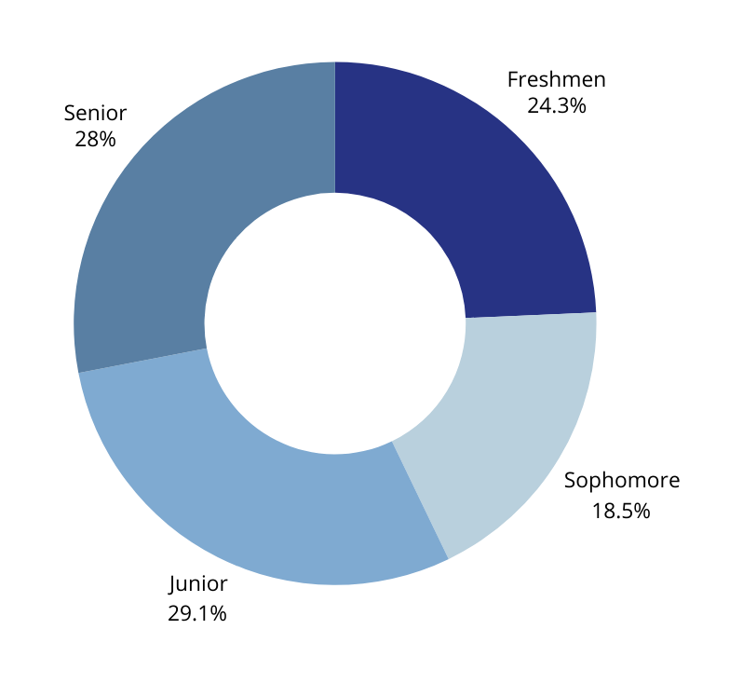
Segmentation
Our segmentation reveals concentrations in juniors, seniors, and freshmen, each with distinct experiences and maturity levels.
Travel patterns highlight a significant segment covering 5 to 10 kilometers, influencing our targeting approach.

Slide 6
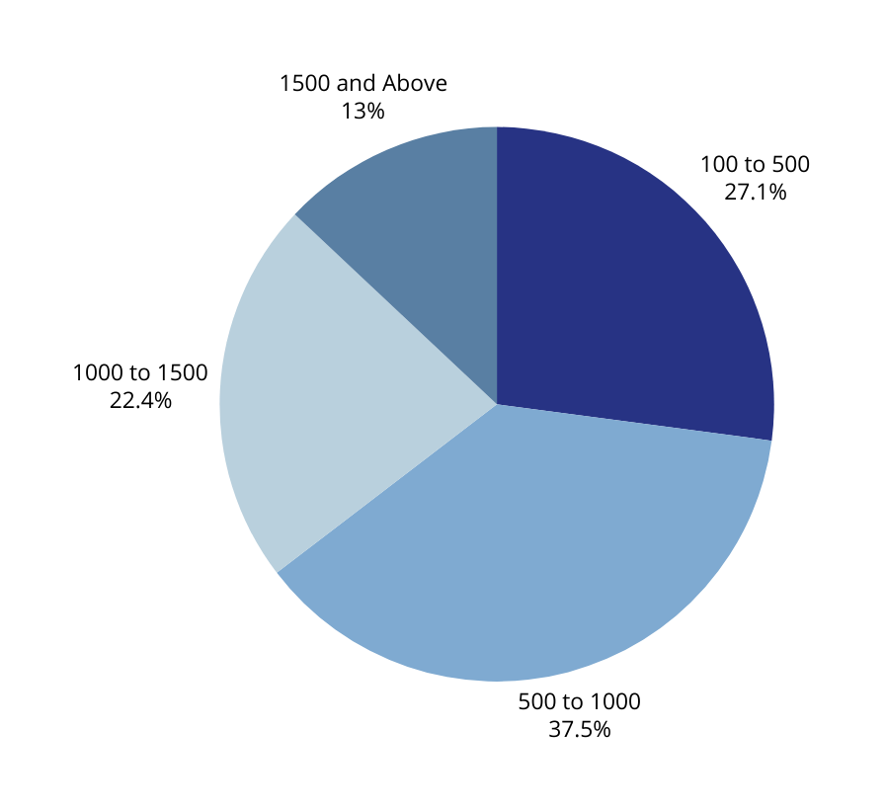
Targeting Strategy
In line with STP analysis, gaming stalls, proven hits among SZABIST's demographic, form a crucial part of our targeting strategy.
Lower prices, discounts, and attractive prizes cater to the diverse spending habits identified in our survey.

Slide 7
Positioning SzabistChallengeCentral as an enhanced social experience within the campus is central to our STP strategy.
By prioritizing affordability, we position ourselves as the foremost destination where students can indulge in a unique and enjoyable social atmosphere without financial constraints.
Positioning

Slide 8

Stall Logo
DESIGN - Sharp. Stimulating. Bold.
COLORS - Navy Blue, White & Black.
MEANINGS - Enthusiasm, Challenges & Entertainment.
ATTRACTION - Colors, Character & Elements used in logo.

Slide 9
Balloon Bonanza Bash Fast-Paced Game:
3 shots pop the balloons in a given time for exclusive rewards hidden in the balloons.
Dart Delight Carnival Challenge:
Classic carnival game with precision darts.
Rewards skill, accuracy, and strategy.
Offers a captivating carnival experience.
Battle Arena Arcade:
Gaming showdown with Tekken, Mortal Kombat, and FIFA.
Top-notch equipment and latest game editions.
Social gaming hub for connecting with fellow gamers.
Product Profile

Slide 10
Fixed Costs:
Chart Papers = PKR/- 280
Tapes = PKR/- 360
Thermocol Sheet = PKR/- 600
Stall Cost = PKR/- 700
Spizer Glue = PKR/- 280
Stickers = PKR/- 80
Balloons = PKR/- 300
Printing Expense = PKR/- 160
Other Costs/Variable Costs:
Estimated Reward Expense = PKR/- 280 - 1500
Initial Investment = PKR/- 3000
Total Expected Investment = PKR/- 3500 - 4000
Expected profits = PKR/- 1000 - 2000
Cost Breakdown

Slide 11
FIFA 22/TEKKEN/Mortal Kombat:
PKR 150/- ,2 players,
PKR 300/- ,4 players. (applicable for FIFA only)
HIT THE DART:
3 darts for PKR/- 150
Any individual who hits the bulls eye can buy any product of their choice from other available stalls at SZABMART. Likewise, scoring a minimum of 50 points or above will earn in winning a prize.
(max limit: PKR/- 300)
BALLOON POPPER:
3 hits for PKR 150/-, the player will get whatever prize there is in the balloon they pop.
Price & Rewards

Slide 12
THANK YOU

